Slide 1
Common Emitter
Bulletproof designs
Notes:
A lot of designs of common emitter circuits that you encounter have serious design flaws, usually very poor low frequency response and distortion of large signals.
One of the major problems is an unrealistic expectation of the voltage gain achievable from a single transistor stage, without sacrificing linearity or response.
This presentation illustrates those pitfalls and presents solutions to create usable circuits.

Slide 2
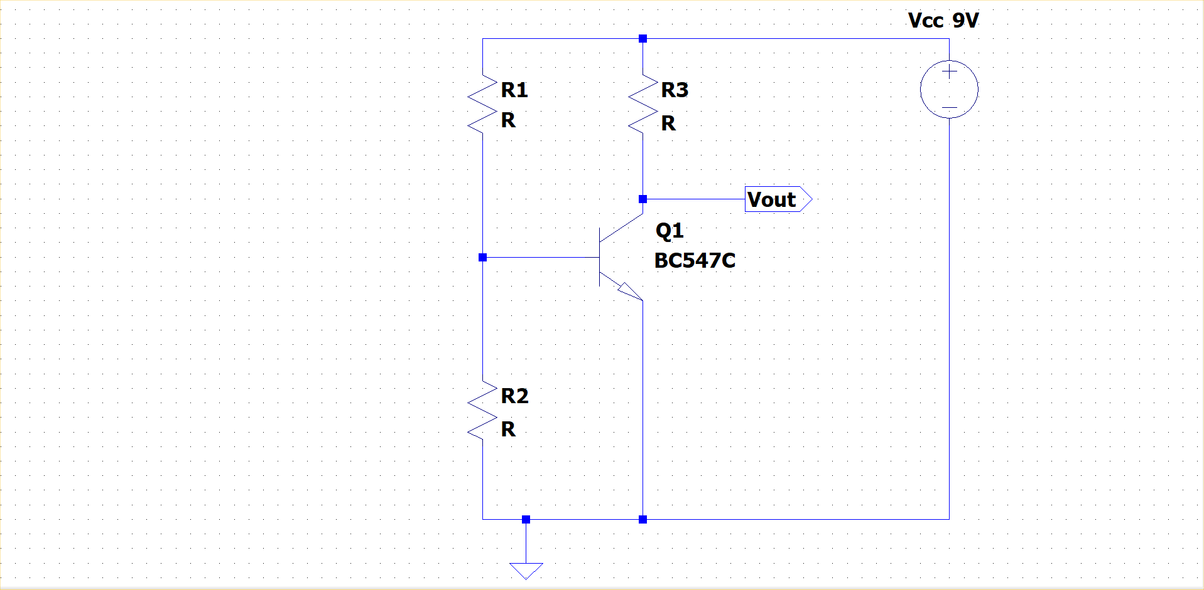
Basic common emitter
Notes:
This is the basic layout of a common emitter stage.
The input signal is applied to the base of Q1 and the output signal is taken from its collector.

Slide 3
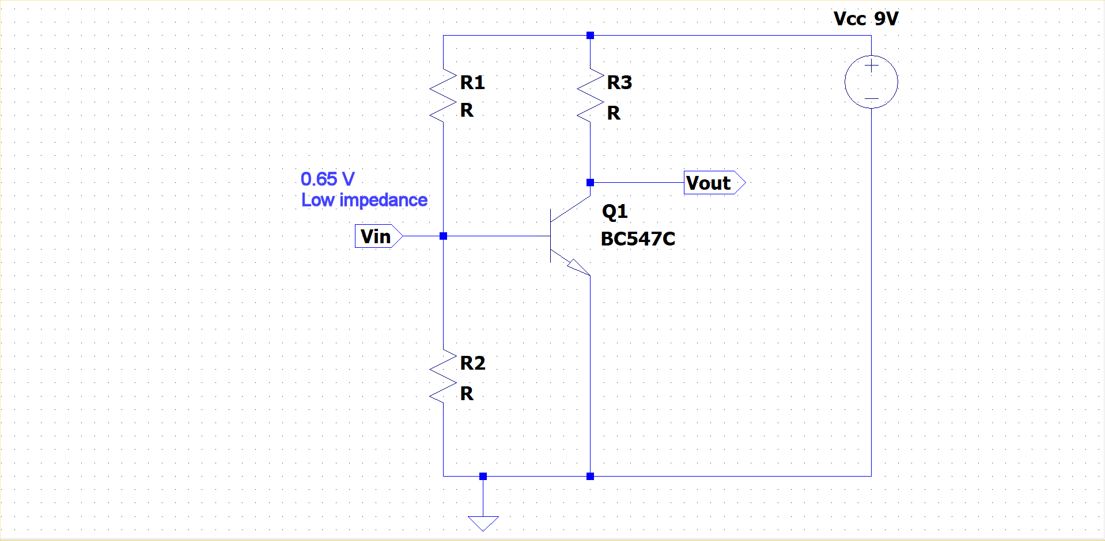
Input level and impedance
Notes:
However, the input at the base of Q1 will be at a mere 650mV above ground because the base-emitter junction of the transistor cannot vary much from that when the transistor is in its linear region – i.e. working as an amplifier.
That is equivalent to saying that the impedance of the transistor at its base will be low, since changes of current into the base will produce very small changes in the voltage at that point.
The current flowing into the transistor’s collector - its collector current - is difficult to determine in this circuit and any set of resistors you use for R1, R2, R3 can produce quite different results when used with a different sample of the same transistor. In addition the collector current will change with temperature.
Since the collector current determines the voltage at the collector of the transistor, this will also change with different samples and with temperature. That is not desirable design.
The collector voltage should be somewhere in the middle of the range between the supply voltage and the voltage at the emitter, so that the output can swing positive close to the supply rail and negative close to the saturation point of the transistor – that is when the collector voltage approaches the emitter voltage.
If we denote the collector current as Ic, then we set the quiescent bias point for the output by choosing the value for R3 so that Ic x R3 is approximately equal to half the supply voltage. So R3 = Vcc/2.Ic
This circuit has a high, non-linear voltage gain, which is determined by the ratio of the change in output voltage to the change in input voltage that caused it. A small change in input voltage will result in a change in the emitter current as if a small resistor were present in the emitter, which we can call the intrinsic emitter resistance. At room temperature, that resistance is approximately equal to 25mV or 26mV divided by the emitter current.
[Aside: At 20C, Vtherm = 86.17μV x 293 = 25.24mV ≈ 25mV. At 25C, Vtherm = 86.17μV x 298 = 25.68mV ≈ 26mV. I’ll use 25mV.]
Since modern small-signal transistors have high current gains (the ratio of the collector current to the base current), the emitter current and collector current can be assumed to be equal in this configuration.
So the change in collector current for an input voltage signal (Vin) equals Vin / the intrinsic emitter resistance. But the change in output voltage (Vout) is equal to the change in Ic (or Ie) times R3 which then equals R3.(Vin/re). The gain is therefore Vout / Vin = R3.(Vin/re) / Vin = R3 / re.
Therefore the gain is equal to the ratio of the collector resistor to the intrinsic emitter resistance. Since R3 = Vcc / 2.Ic and re = 25mV / Ic, it can be seen that the voltage gain Av = (Vcc/2.Ic) / (25mV/Ic) = Vcc / 50mV at room temperature as long as the collector current doesn’t change significantly. Note that the maximum attainable gain depends on the supply voltage, and nothing else.

Slide 4
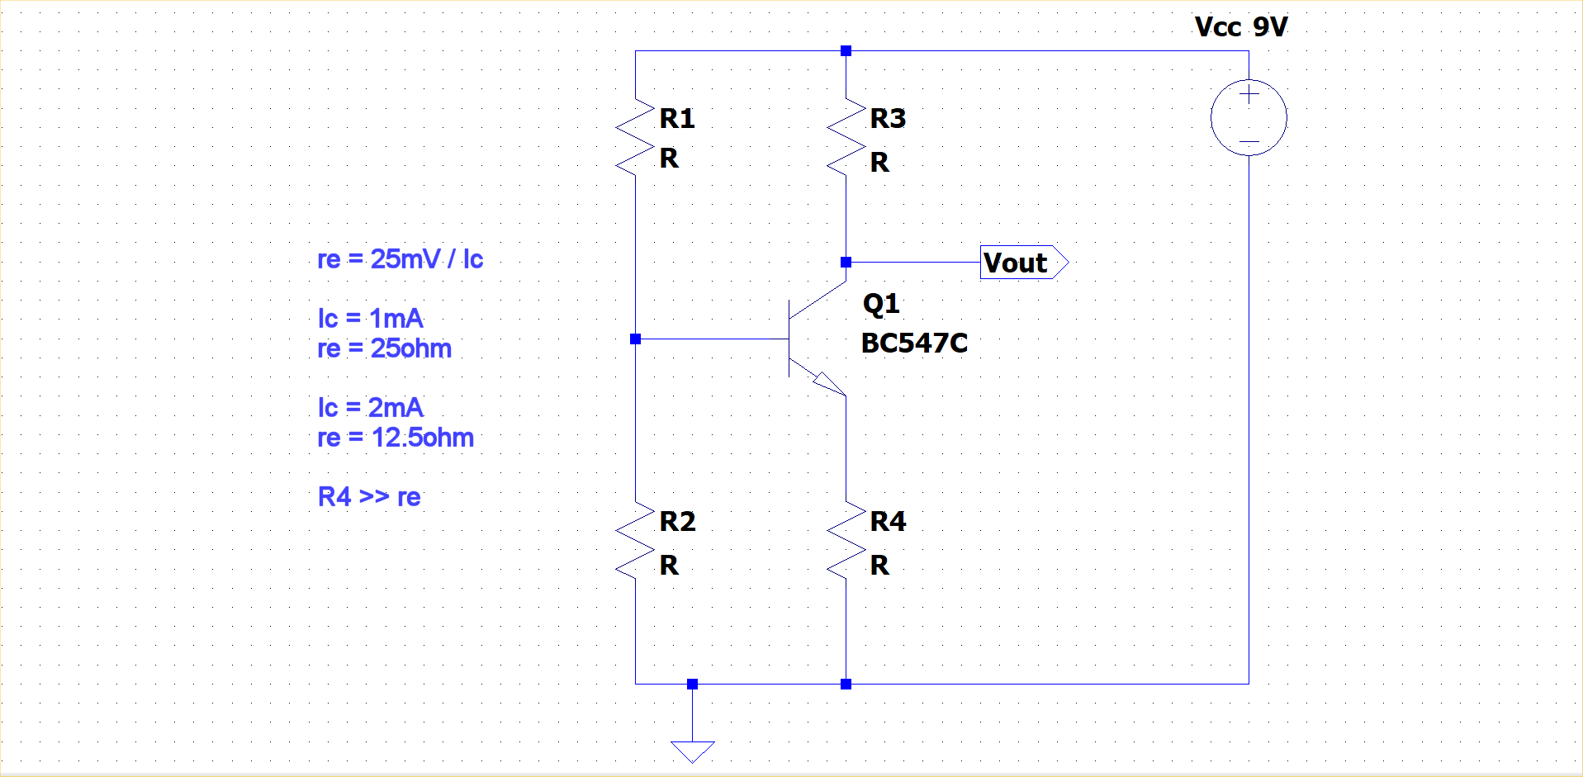
Collector current and emitter resistor
Notes:
An increase in input voltage will produce an increase in emitter current, giving a increase in collector current which increases the voltage across R3. Since the top of R3 is fixed at Vcc, the voltage at the collector will decrease. This makes the circuit an inverting amplifier.
In the basic circuit, the gain is given by R3/re, but re is inversely proportional to the collector current. That means that when the output swings positive, Ic will be less, re will be greater and Av will decrease. Conversely, when the output swings negative, Ic will be greater, re will be less and Av will be greater.
The circuit amplifies the negative part of the input signal more than it amplifies the positive part, and that creates significant distortion.
To improve the circuit, we can add an emitter resistor R4 between the emitter and ground.
The emitter current must now pass through both R4 and re, the intrinsic emitter resistor. That will reduce the gain to R3 / (R4 + re), but if we set R4 >> re, then the changes of re become negligible and distortion is much reduced. We can now approximate the gain to R3 / R4 which no longer depends on the transistor or the temperature.

Slide 5
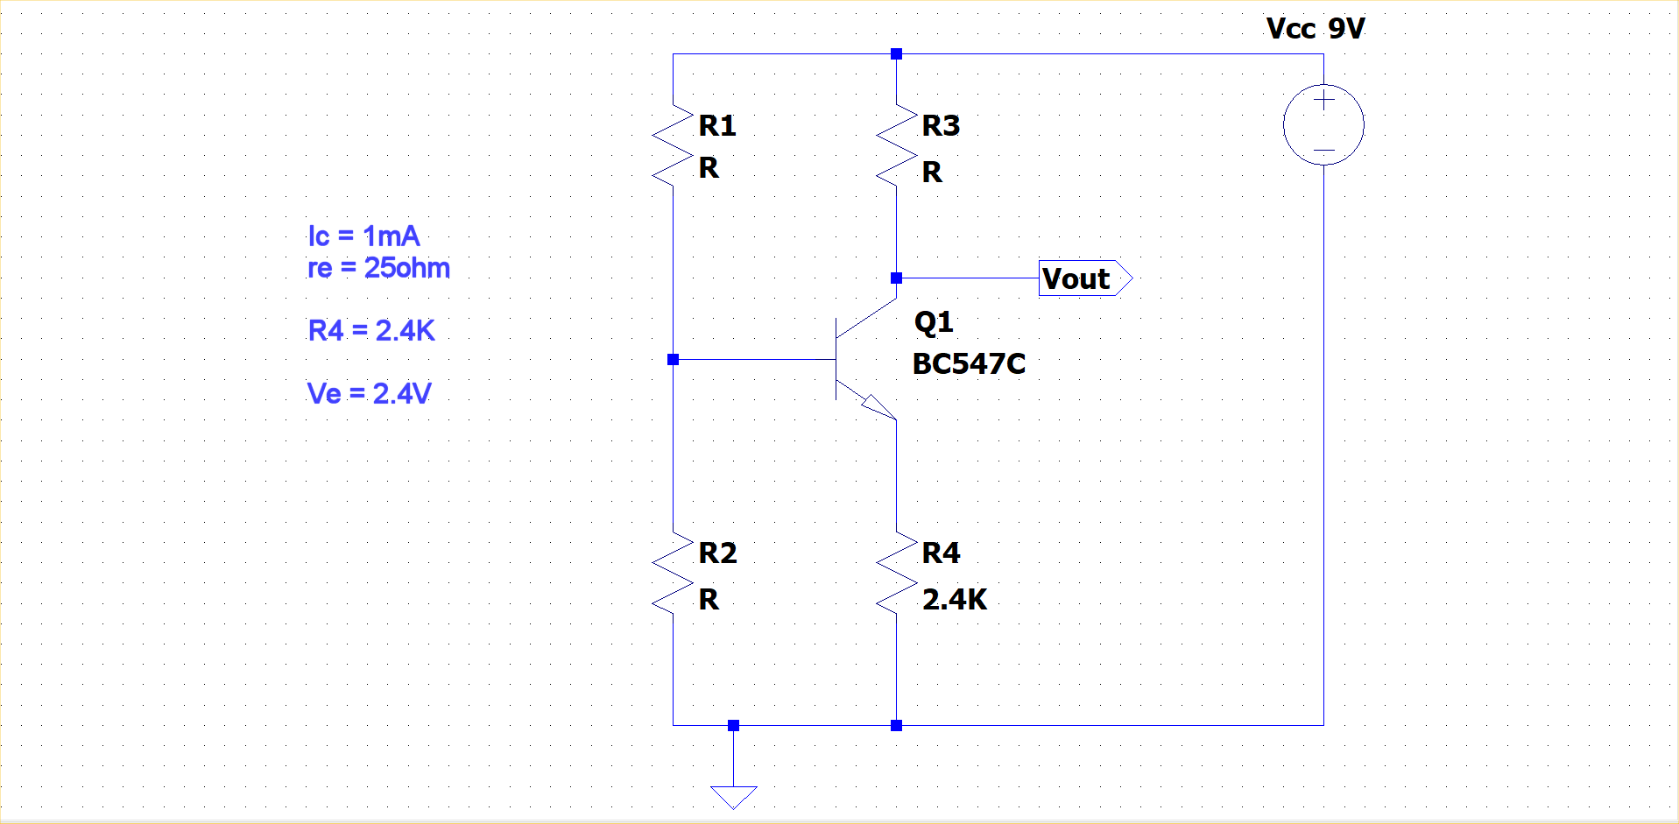
Setting emitter bias voltage
Notes:
With the emitter resistor in place, we can determine the voltage at the emitter by noting that the emitter (or collector) current will pass through R4 and so Ve = Ic.R4.
An example would be to aim for a collector current of 1mA. Then re = 25mV / 1mA = 25R. Taking R4 ≈ 100 x re, we can set R4 = 2.4K
That sets Ve at 2.4K x 1mA = 2.4V.

Slide 6
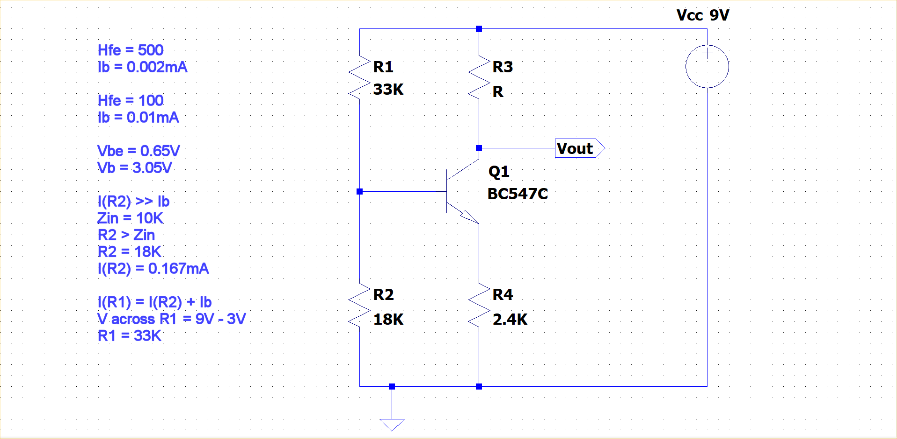
Setting base bias voltage
Notes:
The BC547C is a high current gain transistor with a β typically around 500. With other transistors, you may have to design for β around 100. There’s rarely any point in using transistors with β below that for low-power applications.
With a Ic = 1mA, the BC547C will have a base current of 0.002mA (2 microamps). A 2N2222 with its typical β of 100 would have Ib = 0.010mA (10 microamps).
Since Vbe is always around 650mV with a collector current of 1mA for most silicon transistors, we can calculate the required voltage at the base as the voltage at the emitter plus 0.65V. In this example, that is 2.4V + 0.65V = 3.05V.
If we choose R1 and R2 so that the current through them is significantly greater than the transistor’s base current, we can ignore the effect of that base current on the voltage formed by the resistor divider. Normally, R1 will be greater than R2 so that we don’t lose too much voltage across R4.
The input impedance of the circuit will be less than R2. We will often have a requirement for the input impedance. If we need a Zin of at least 10K, we will calculate R2 to be greater than that – say 18K and check that the current through it will be significantly greater than Ib. If it isn’t, then we have to start the calculations again in order to reduce the collector current until the base current is small enough to allow R2 to be bigger than 10K.
This shows how the collector current (along with transistor β) will determine the input impedance. Smaller collector currents and higher β will yield higher input impedances.
In this example the current through R2 will be 3.05V / 18K = 0.17mA (or 170 microamps). That is significantly more than Ib for any usual modern general purpose transistor, so our assumption to ignore Ib is justified.
Now that we know the current through R1 and R2, we can calculate R1 to be (9V – 3.05V) / 0.17mA. That’s around 35K, so we can pick 33K, then recalculate the bias point and collector current to make sure it matches our design requirements.

Slide 7
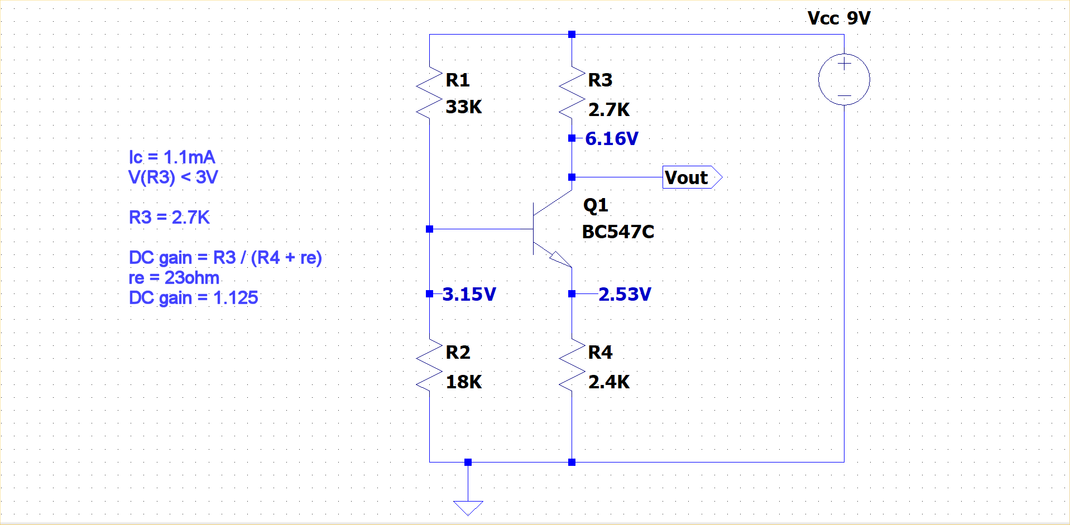
Collector resistor and gain
Notes:
We recalculate the bias points:
Vb = Vcc x R2 / (R1 + R2) = 3.17V.
Ve = Vb – 0.65V = 2.52V
Ic = Ie = 2.52V / 2.4K = 1.05mA
These are close to the design values.
The voltage at the emitter is around 2.5V, so the transistor will saturate if its collector voltage drops to Ve + Vce(sat) = 2.5V + 0.2V = 2.7V.
We will want to set the voltage at the collector to about half-way between Vcc and 2.7V, so that’s around 5.9V. That looks reasonable: we drop around 1/3 of Vcc across each of the emitter resistor, the transistor and the collector resistor.
So R3 = (9V – 5.9V) / 1.05mA = 3K, and we can select 2.7K.
I built the circuit and measured the voltages at emitter, base and collector, and marked them on the diagram. Changing the transistor didn’t alter them noticeably. Altering the supply voltage scaled the values fairly linearly.
Since re is << R4, the voltage gain of the circuit is R3 / R4 = 2.7K / 2.4K = 1.125. That gives very good dc stability, but isn’t much use for amplifying ac.

Slide 8
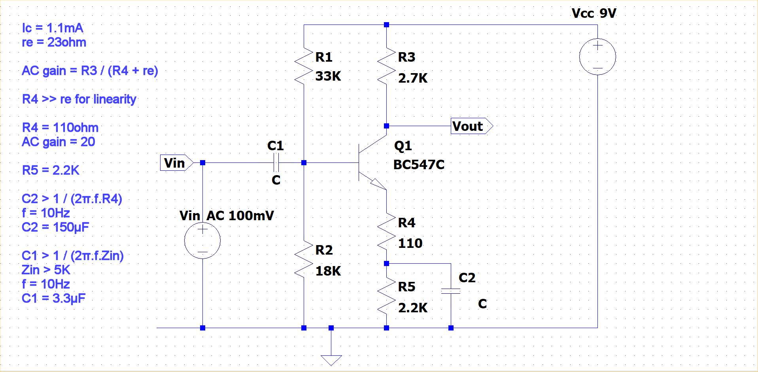
AC gain – split emitter resistor
Notes:
To increase the ac gain, we could bypass the emitter resistor R4 with a capacitor large enough that re remains the only significant resistance at frequencies of interest, but that would leave the gain strongly dependant on re and re-introduce all of the distortion that we removed when adding R4.
A good compromise between gain and distortion is to split the emitter resistor and only bypass one part of it. The circuit now has a smaller R4, which increases the gain, but R4 cannot be so small that the changes in re become significant and cause distortion.
At Ic = 1.1mA, re = 23R, so we could choose R4 to be 110R, which is about 5 times as much. Smaller values would increase gain, but also distortion. To maintain the dc bias points we want R4 + R5 to be 2.4K as was used previously. So set R5 = 2.2K.
The ac gain is R3 / (R4 + re) = 2.7K / (110R + 23R) which is about 20, a much more useful value.
The bypass capacitor has to have a reactance at frequencies of interest much smaller than R4, so that neither the capacitor nor R5 has any effect on the gain. If we are dealing with audio amplification, we will want the gain to remain substantially flat from 20Hz to 20KHz.
If we set the lower -3dB frequency to be 10Hz, then C2 = 1 / 2π.f.(R4) = 1/ 2π.10Hz.110R = 144μF. We can use 150μF.
The input impedance at audio frequencies will be the parallel combination of R1, R2 and the input impedance of the transistor looked at from the base, which is β times the emitter resistance. That becomes 33K || 18K || 500x110R = 9.6K typically. However that will be reduced a little if the transistor β is lower, so we might design for a Zin of at worst 5K.
The input capacitor C1 can now be calculated to be 1 / 2π.f.(Zin) = 1 / 2π.10Hz.5K = 3.2μF. We can use 3.3μF for a -3dB frequency of no more than 10Hz.

Slide 9
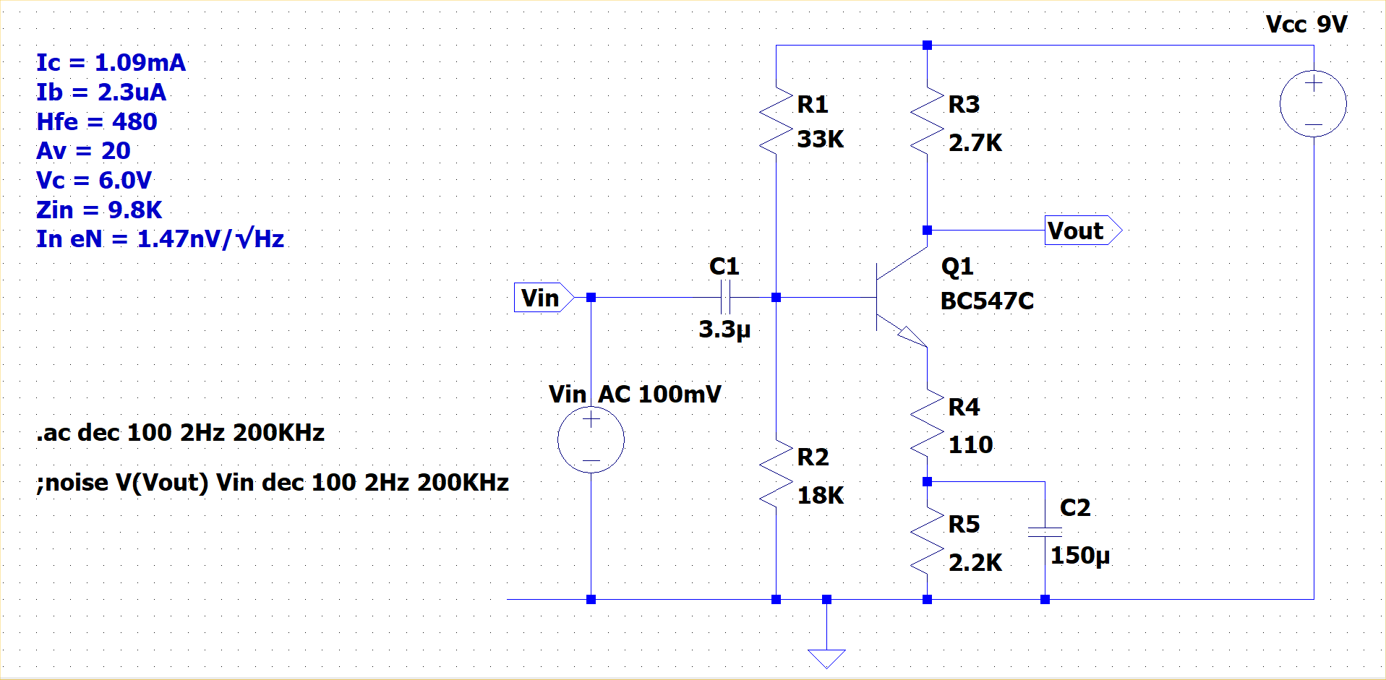
Simulation results
Notes:
This is the LTSpice simulation of the design that we derived, along with the parameters calculated by the simulator.
These are very close to our design values and as a bonus show a very impressive noise figure of 1.47nV/√Hz referred to the input for frequencies where flicker noise (1/f noise or pink noise) is insignificant.
The output impedance is, as expected, equal to the collector resistor, 2.7K.

Slide 10
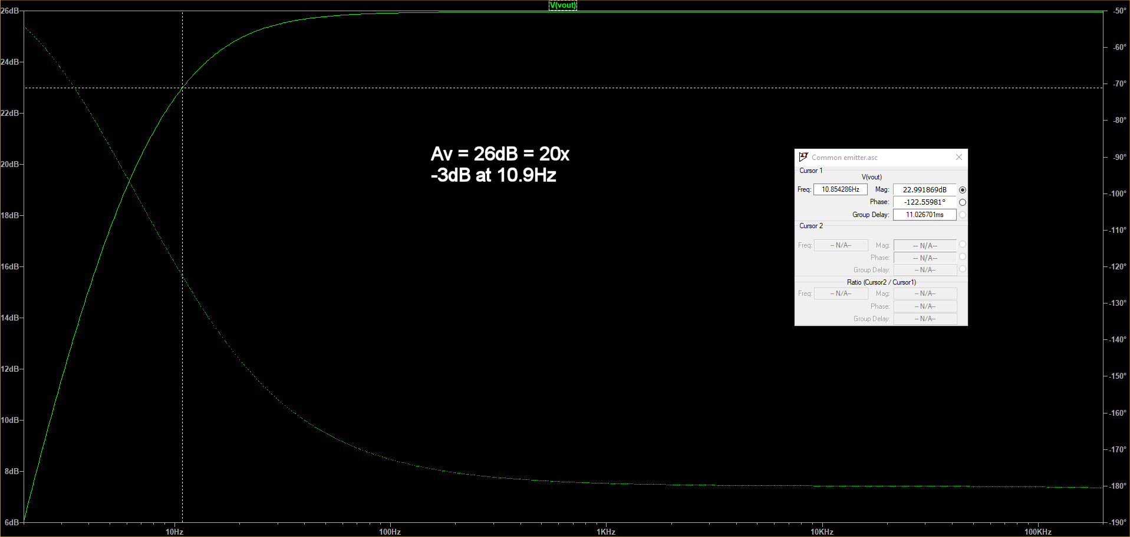
Simulation frequency response
Notes:
This is the LTSpice frequency response simulation, showing a flat gain of 26dB (20x) across the audio range, with a -3dB frequency (cut-off frequency) around 11Hz.

Slide 11
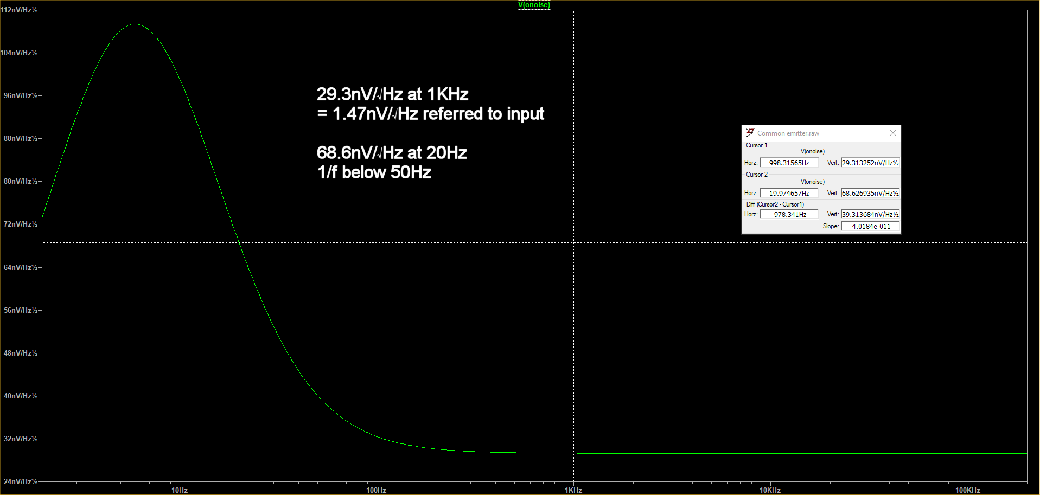
Simulation noise figures
Notes:
This is the LTSpice noise figure simulation, showing a corner frequency around 50Hz.
The noise figure at 20Hz is approximately 70nV/√Hz, which is 3.5nV/√Hz referred to the input.
The flat-band noise is 29,3nV/√Hz , which is just 1.47nV/√Hz referred to input. That makes this sort of circuit a viable pre-amp as a front end for an audio pre-amp such as the NE5532, allowing gains of 100 to be easily achievable, with input referred flat-band noise figures below 2nV/√Hz.

Slide 12
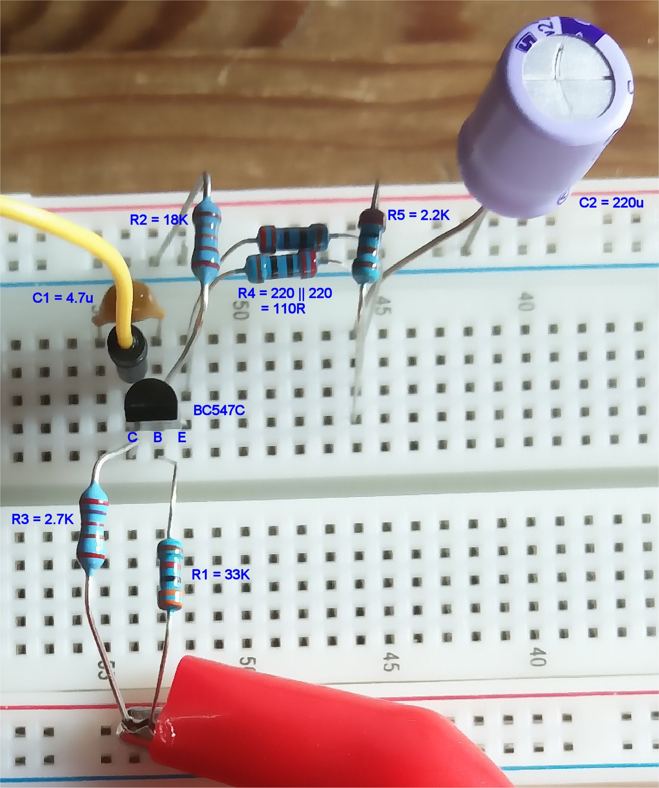
Actual circuit: Ic = 1.08mA
Notes:
Here’s the circuit made up on a breadboard.
The 9V rail is at the bottom and ground is at the top.
R4 is made from two 220R resistors in parallel.
The capacitors are the next ones up in value that I had to hand.

Slide 13
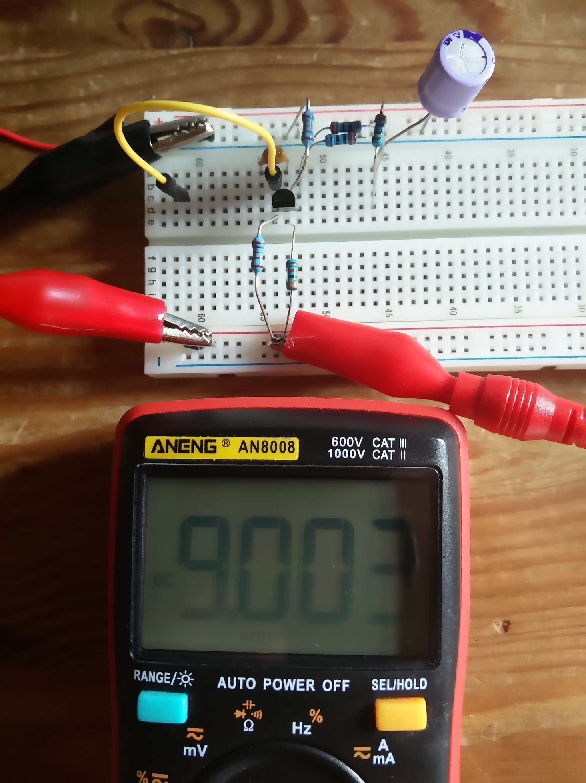
Supply = 9V
Notes:
Supply is 9V.

Slide 14
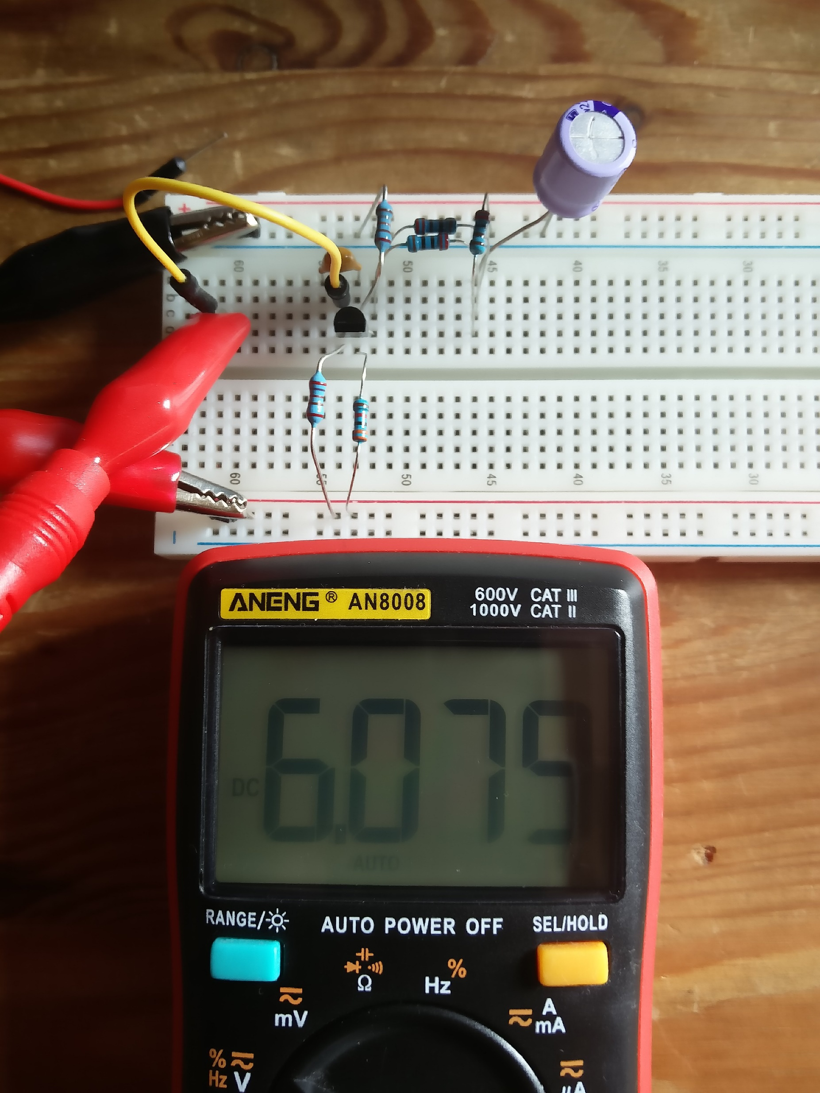
Collector voltage = 6.08V
Notes:
6V at the collector.

Slide 15
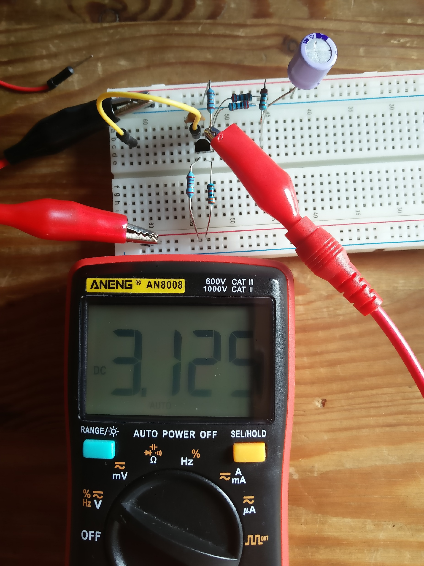
Base voltage = 3.13V
Notes:
3.1V at the base.

Slide 16
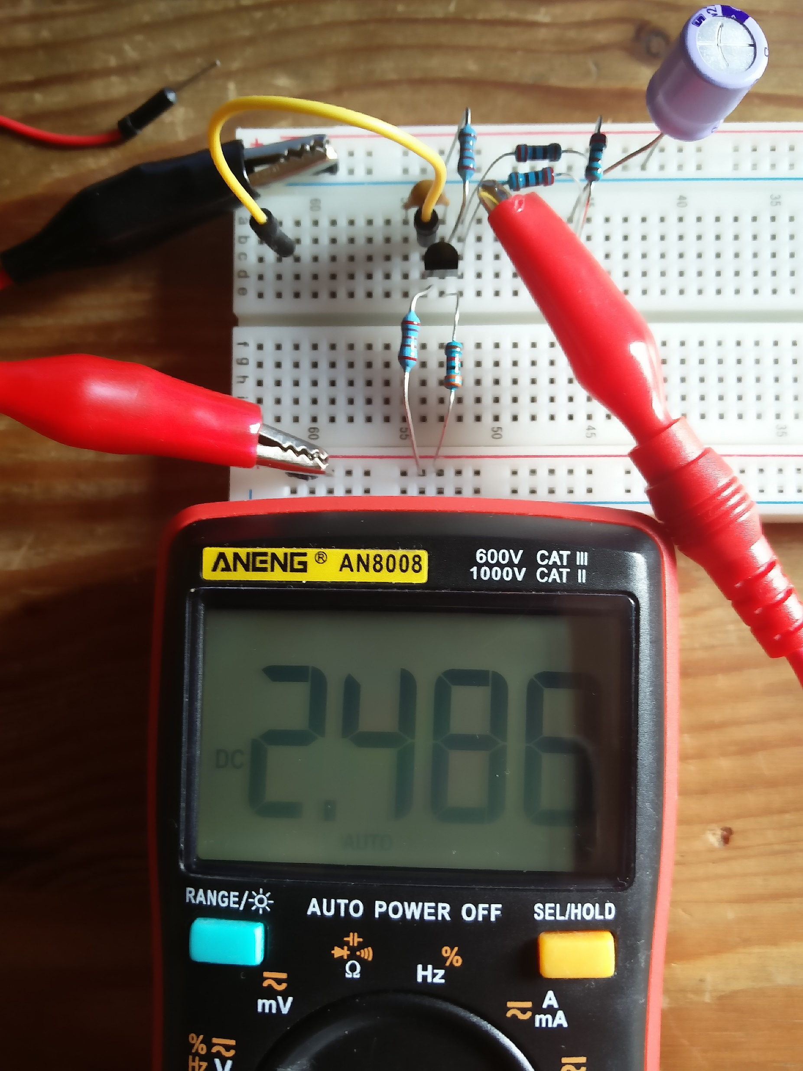
Emitter voltage = 2.49V
Notes:
2.5V at the emitter.

Slide 17
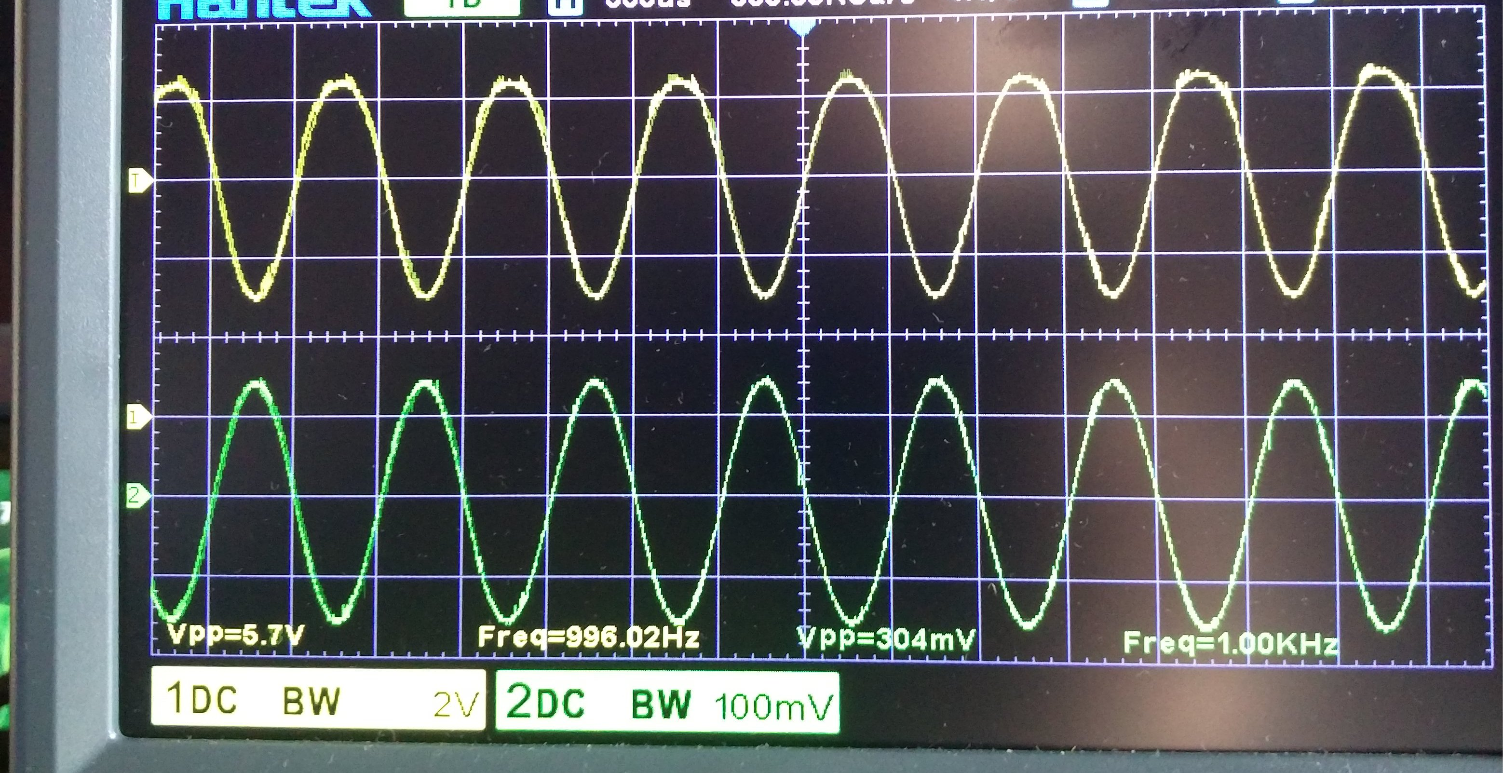
Input = 0.3Vpp @1KHz; Output = 5.7Vpp; Av = 19
Notes:
A 300mVpk-pk input signal at 1KHz (green trace) and the resulting 5.7Vpk-pk output (yellow trace), giving a gain of 19.
The output swings close to the 9V rail and close to the saturation voltage of the transistor. About 2.9V at lowest and 8.6V at maximum.
With such a large swing, there is some visible non-linear distortion (the positive peaks are rounded and the negative peaks are spiked).

Slide 18
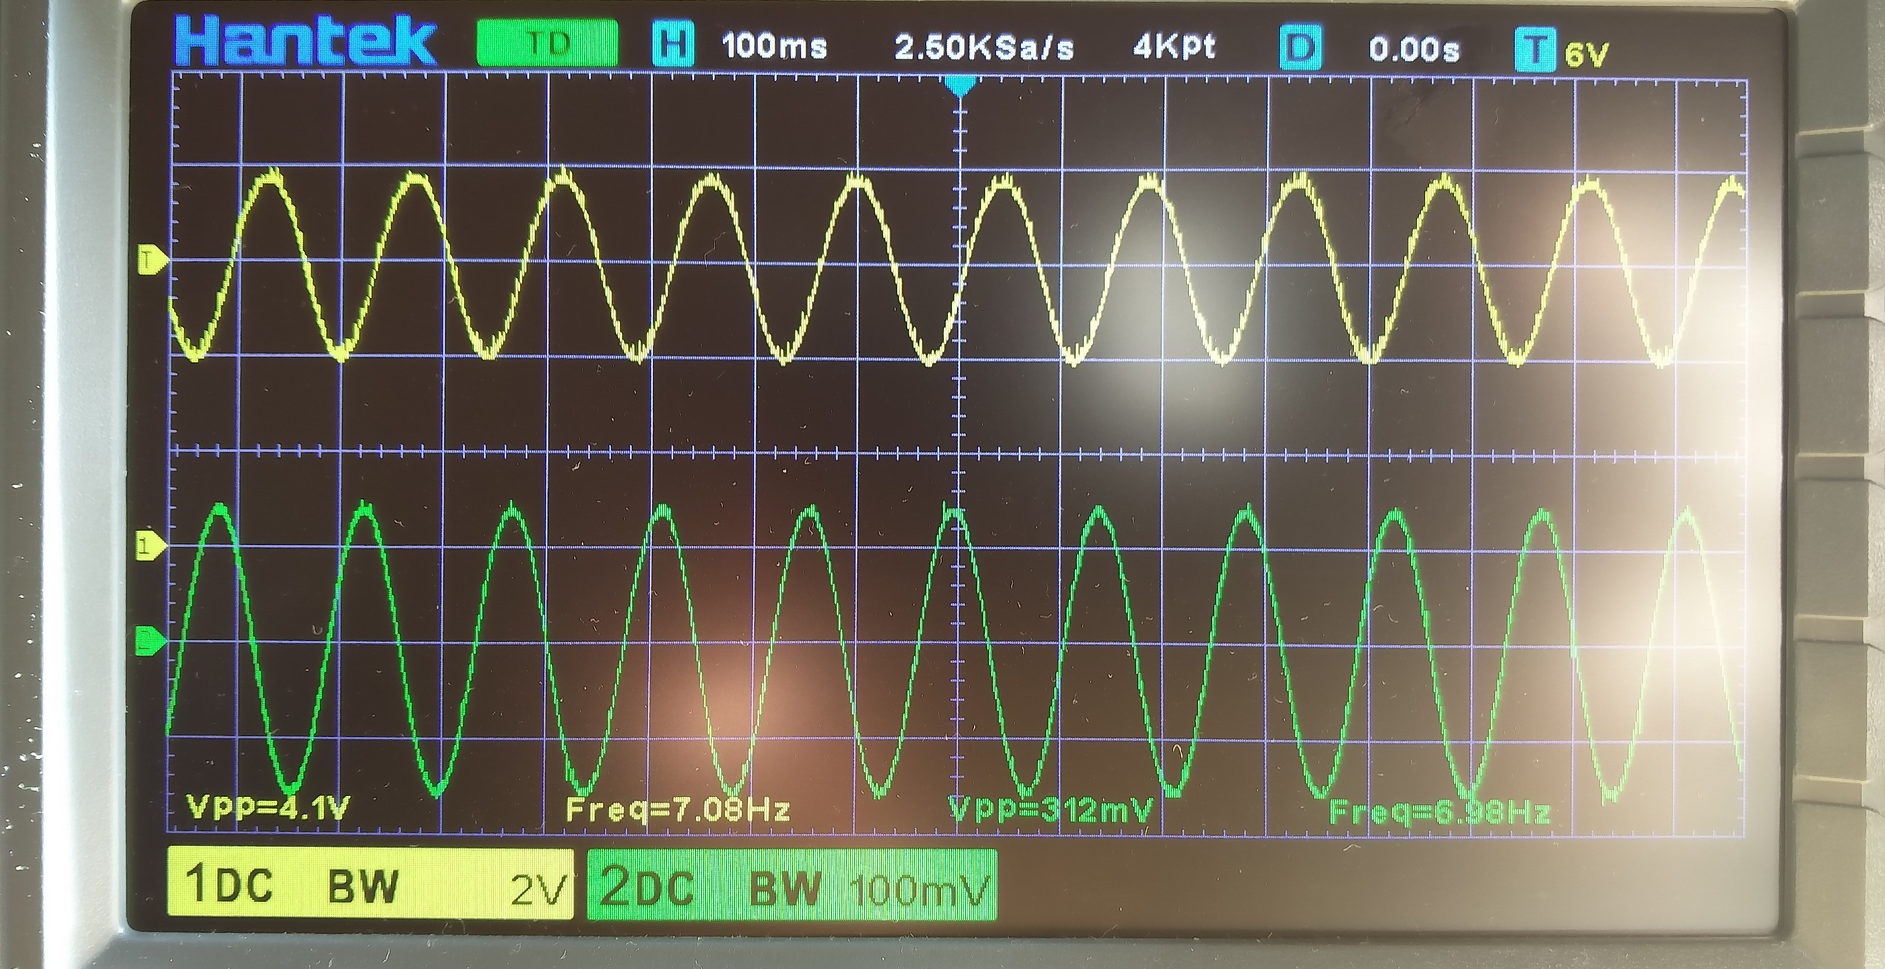
Input= 0.3Vpp @7Hz; Output = 4.1Vpp (-3dB)
Notes:
The response at 7Hz.
The output has reduced to 4.1Vpk-pk which is 70% o
f its mid-band value.

Slide 19
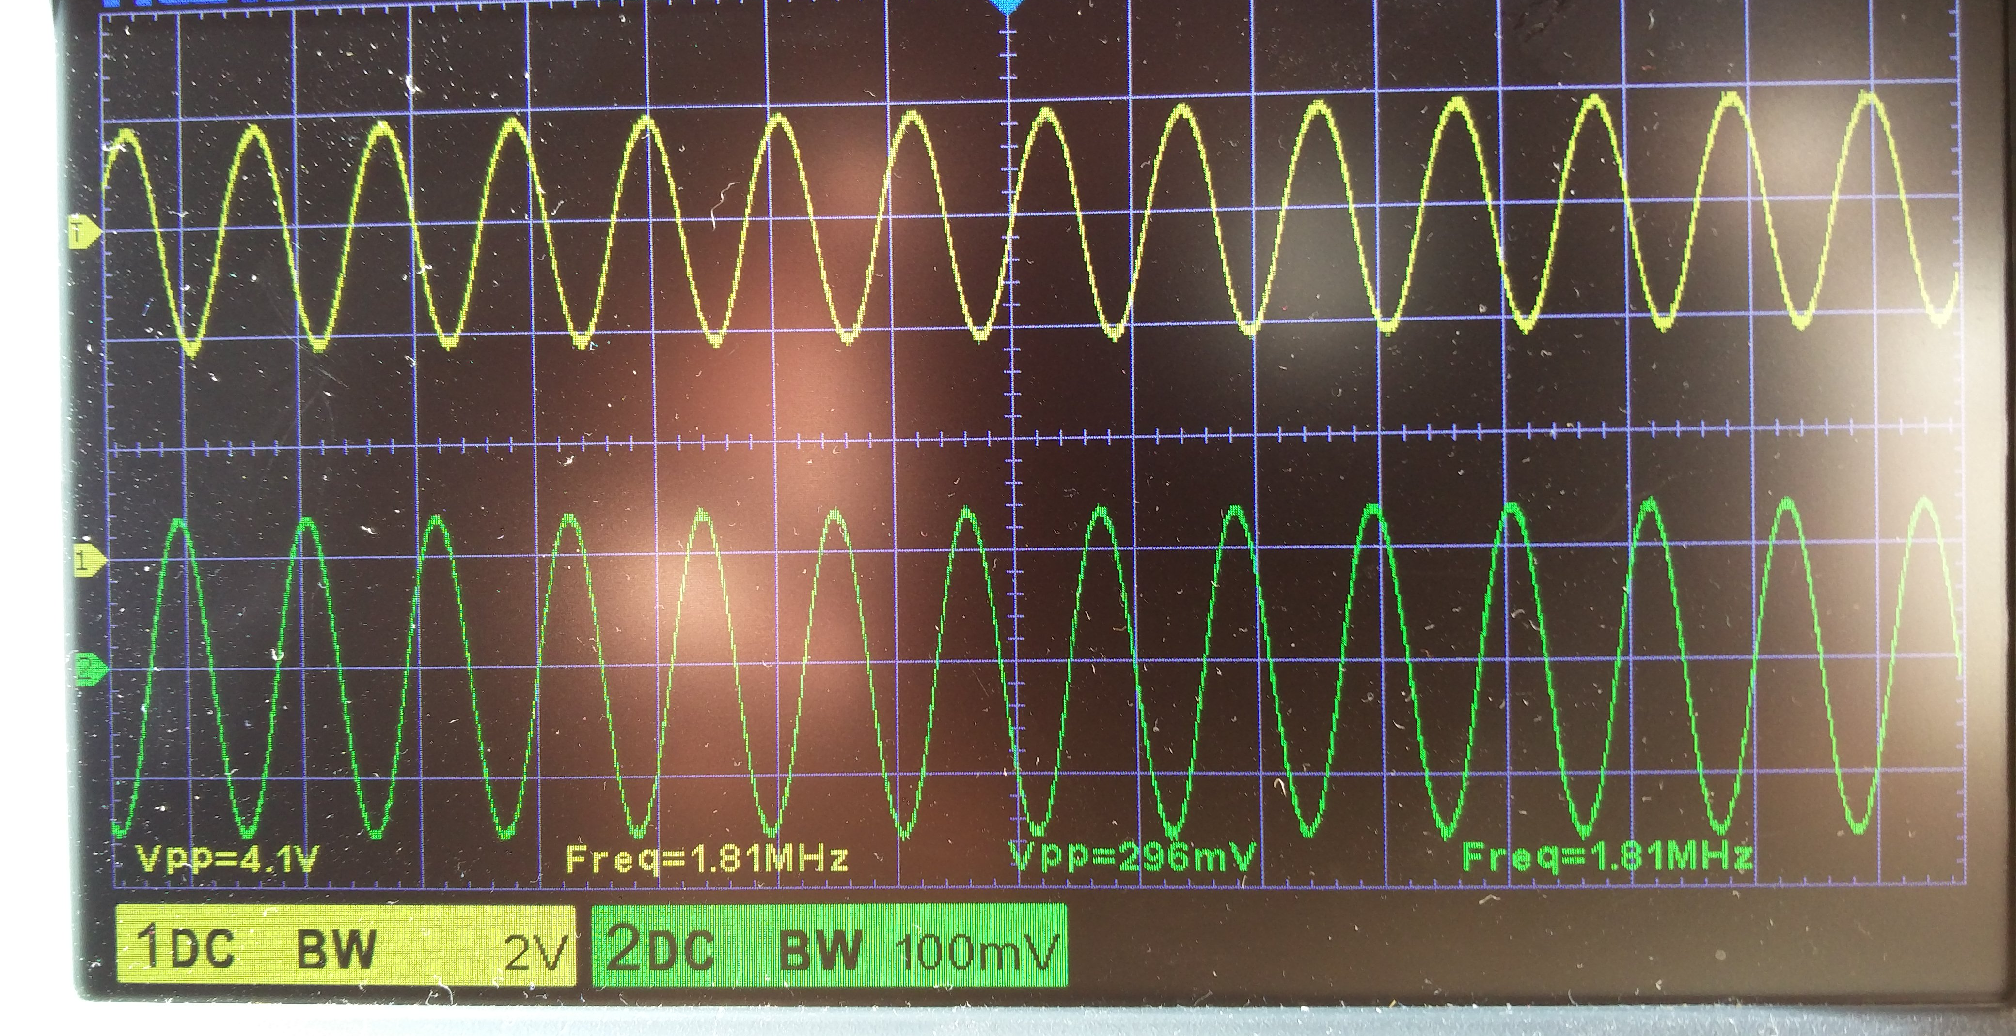
Input = 0.3Vpp @1.8MHz; Output = 4.1Vpp (-3dB)
Notes:
The response at 1.8MHz.
The output has reduced to 4.1Vpk-pk which is 70% of its mid-band value.
The gain is substantially flat from 7Hz to 1.8MHz.

Slide 20
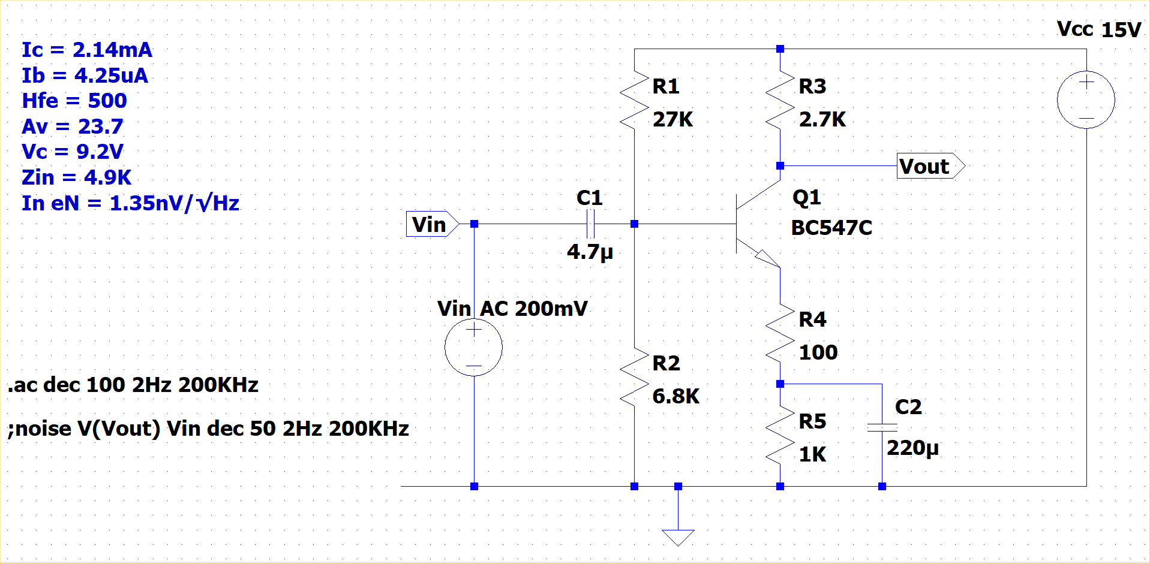
Increasing the collector current
Notes:
This is an LTSpice simulation of the circuit modified to give a collector current twice as large which would result in decreased input and output impedances. The input impedance is now 4.9K, although with the high-gain BC547C, there is sufficient headroom to double R1 and R2 and restore an input impedance of about 10K.
Using a higher supply voltage allows the output impedance to be increased again to provide a little more gain.
The noise figure is reduced slightly as lower resistance values equate to less noise.

Slide 21
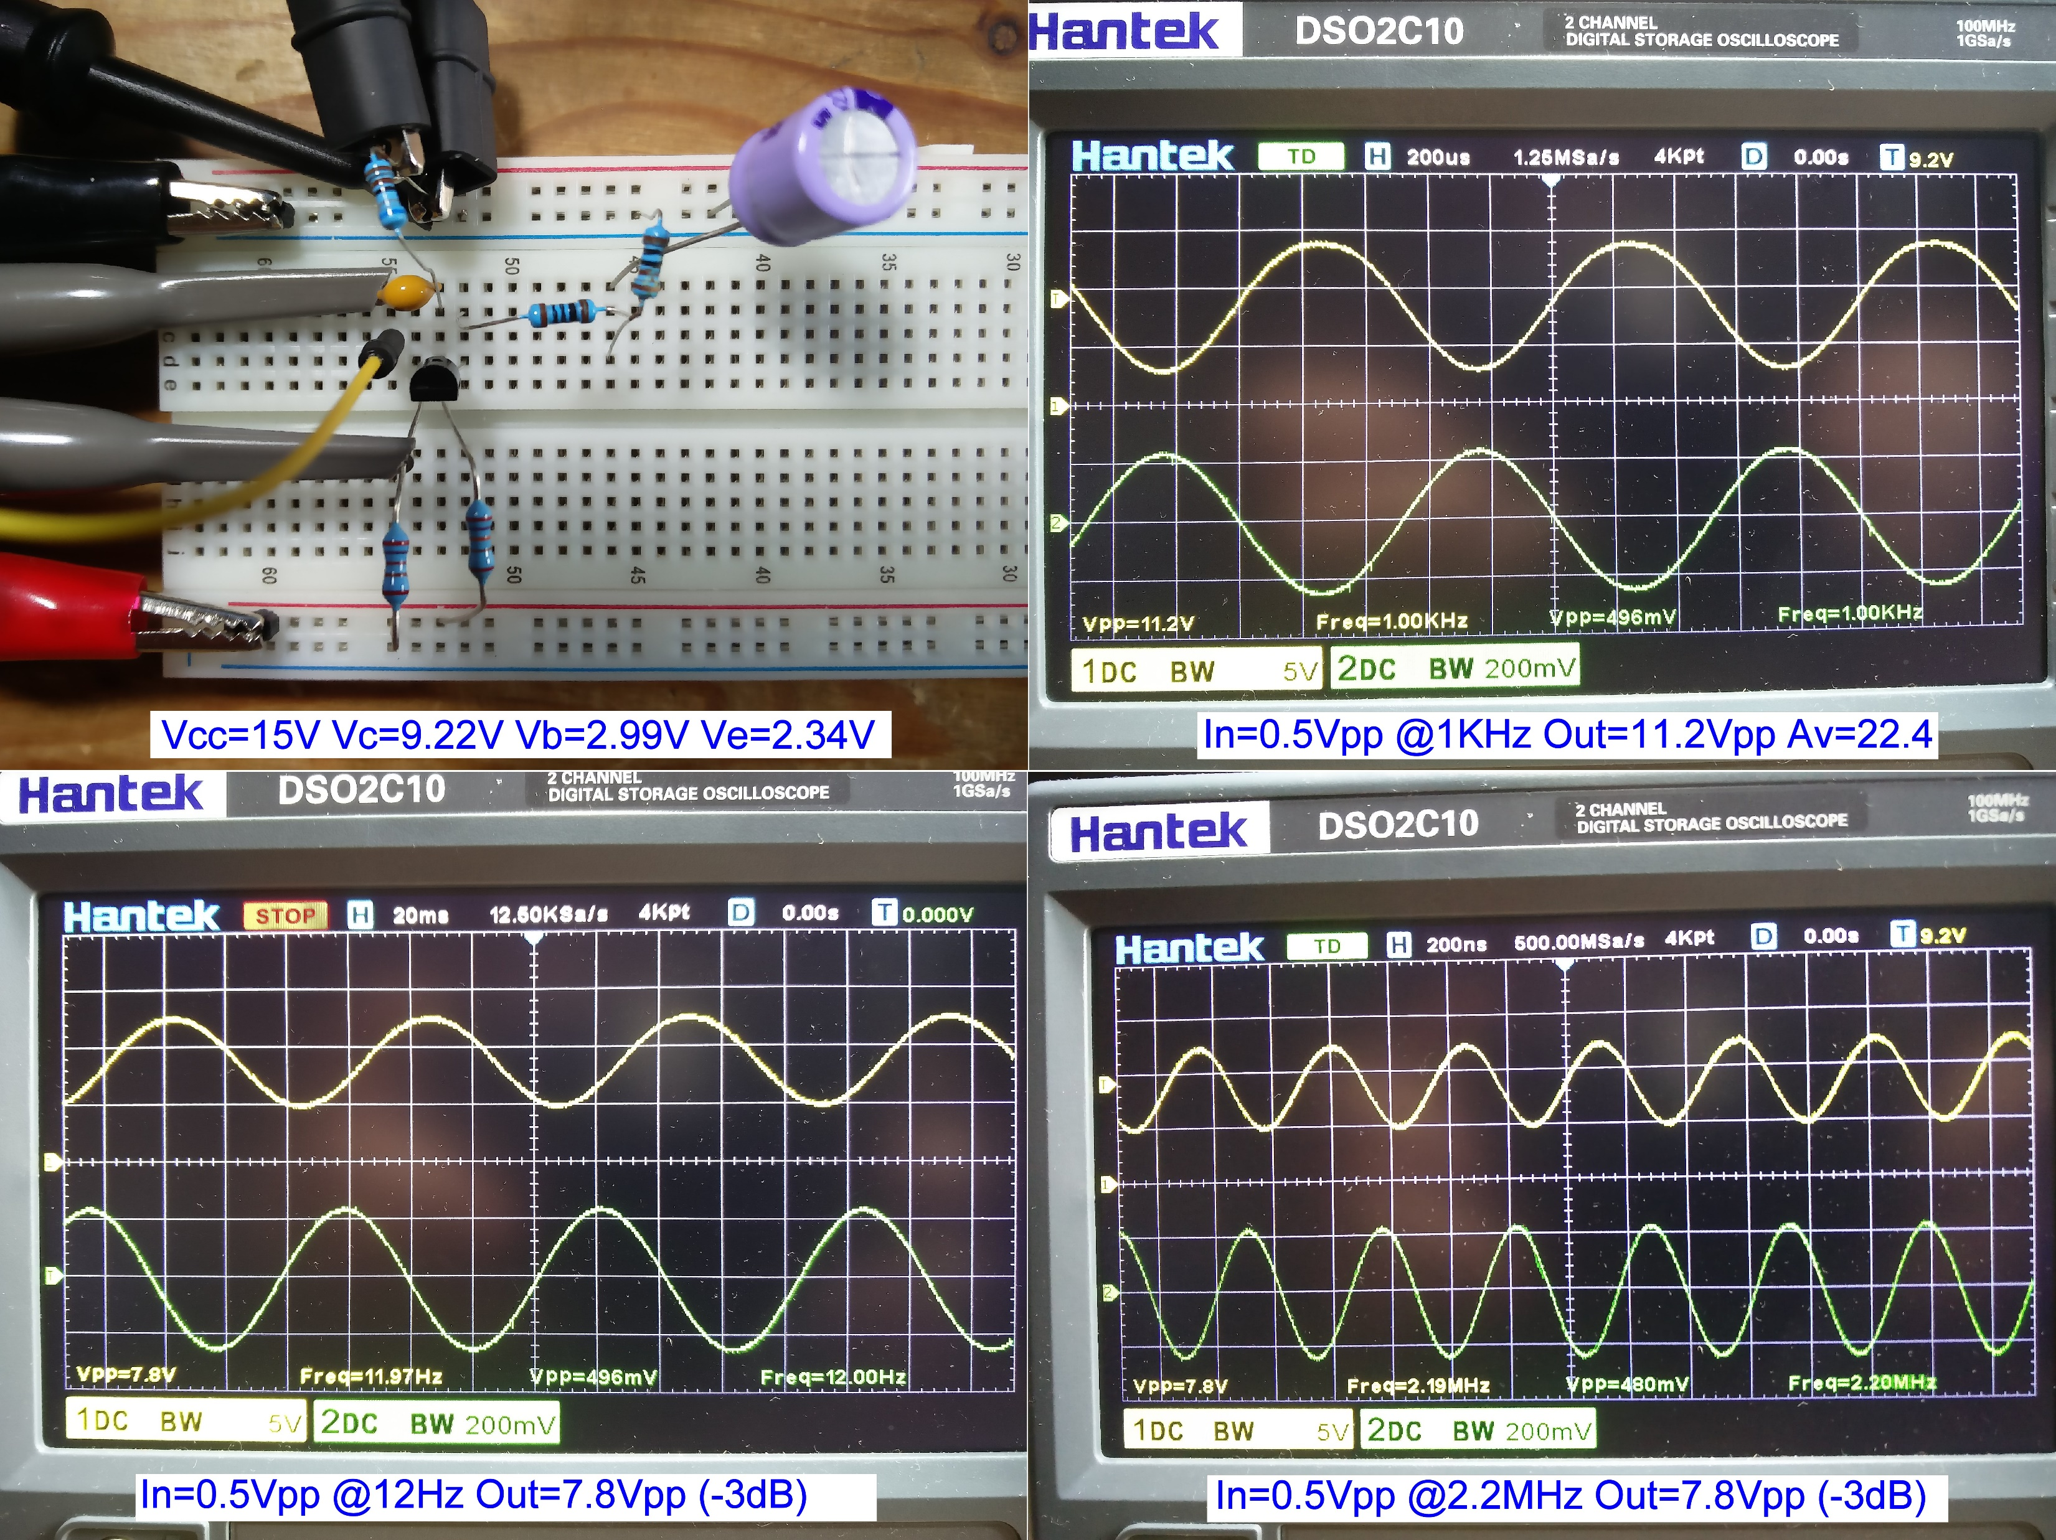
Actual circuit: Ic = 2.14mA
Notes:
The measured quiescent bias points are close to the simulated values.
The higher supply voltage allows a larger output swing.
It also allows R4 to be slightly reduced to 100R, but the doubled collector current halves the intrinsic emitter resistance to about 12R, which is less than one-eighth of R4. Compared with the previous circuit, which had R4 = 5x re, the non-linear distortion is much less noticeable, even with the larger swing.
The bandwidth at -3dB frequencies is 12Hz to 2,2MHz.

Slide 22
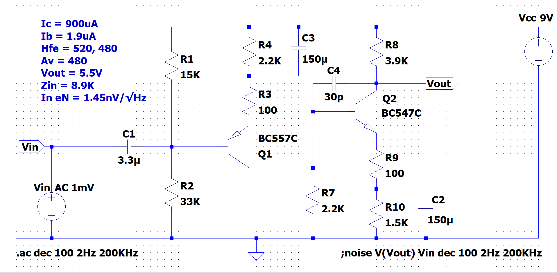
2-stage amplifier
Notes:
To get considerably more gain, two stages of amplification can be used.
The first stage is PNP which illustrates how easy it is to “flip” the design. Using a PNP to drive an NPN allows the collector resistor of the first stage to be the lower base bias resistor of the second stage and eliminates a coupling capacitor between stages.
There is an extra 30pF capacitor giving high-frequency negative feedback from collector to base of the second stage. This reduces the overall gain at frequencies beyond the audio range, ensuring stability and freedom from hf oscillation.

Slide 23
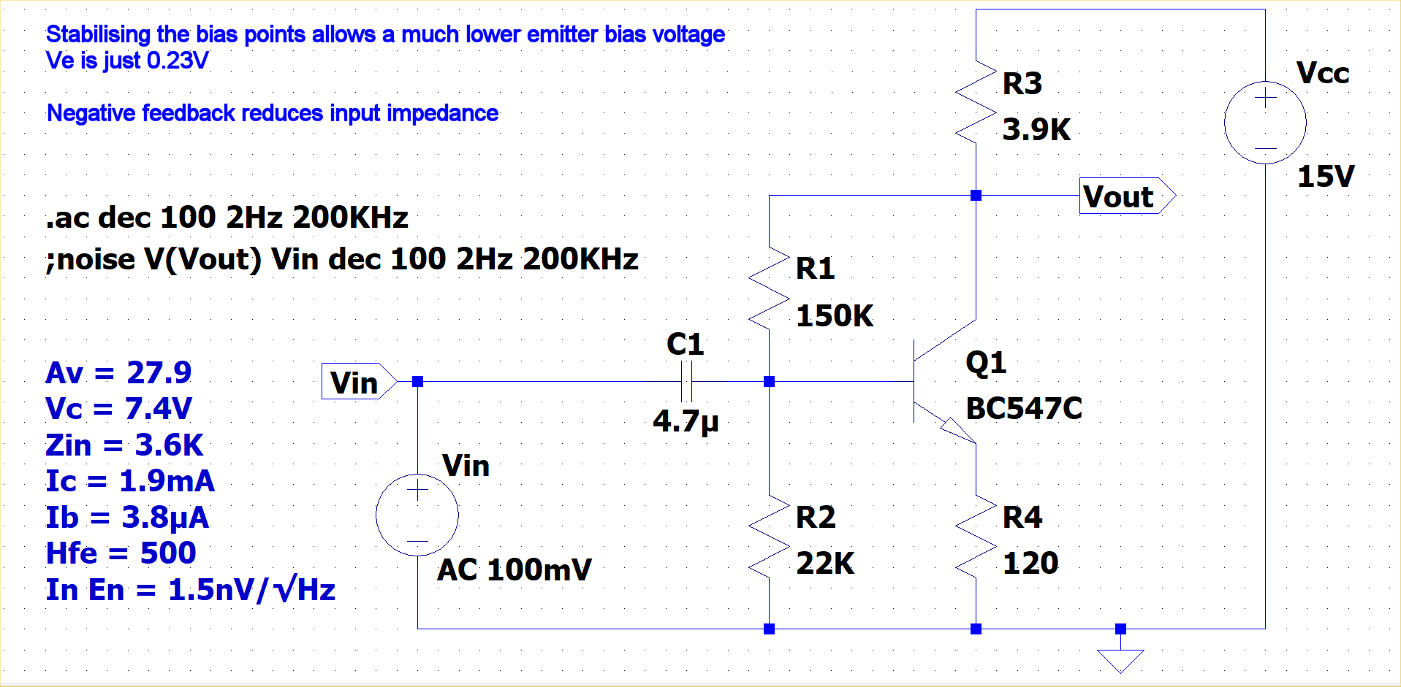
Feedback from collector to emitter
Notes:
Another improvement can be obtained by using the output voltage at the collector to bias the base voltage. This provides extra negative feedback which stabilises the operating points at the expense of reducing the gain slightly. It also reduces the input impedance, but significantly reduces distortion as well.
The stability is improved so much that even a small emitter resistor will give stable bias points, so the voltage across it can be reduced so much that we don’t need a split resistor or an emitter bypass capacitor.
If we aim for a 2mA collector current, re will be about 12R. We can set R4 ten times greater at 120R. That will give about 240mV at the emitter.
The base needs to be 240mV + 650mV = 0.89V.
If we assume that the voltage at the collector is equal to half the supply voltage, and the current through R1 and R2 is significantly bigger than the base current (2mA / 500 = 4μA), then (R1 + R2)/R2 = 7.5V/0.89V which gives R1/R2 + 1 = 8.4, so R1 is about 7.4 times R2.
If we set R1 = 150K and R2 = 22K, the current through them is 7.5V/(150K + 22k) = 44μA which is over ten times greater than Ib. The voltage at the base is then 7.5V x 22K/(150K+22K) = 0.96V. Near enough, because if this increases the emitter current, it will increase the collector current and lower the 7.5V bias point, thus reducing the voltage at the base again.
With 2mA collector current, we want the collector resistor to be Vcc/2 divided by Ic = 7.5V/2mA = 3.75K. Use 3.9K as it’s close enough because the negative feedback will also stabilise the output bias point from changes in R3.
The gain without feedback would be 3.9K / (120R + 12R) = 30. The simulation predicts an actual gain of 28, so the feedback doesn’t reduce it much. However, the input impedance is reduced to 3.6K.

Slide 24
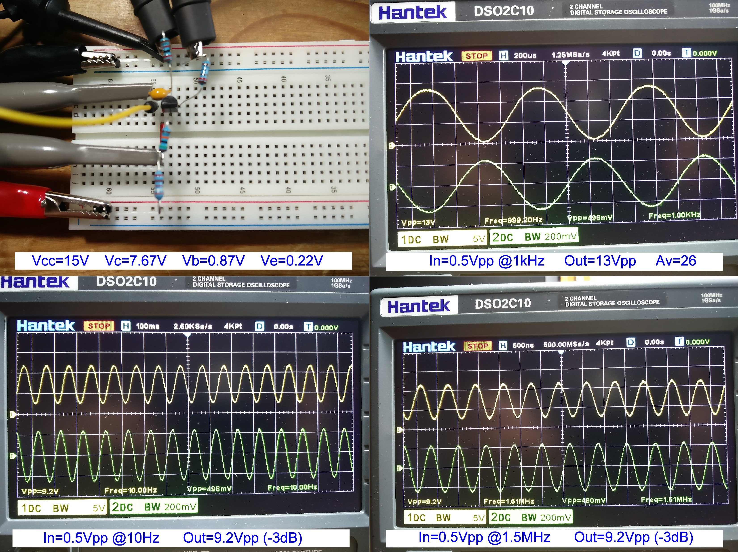
Actual circuit: Ic=1.9mA (C-B feedback)
Notes:
This is the actual circuit built on a breadboard. The measured operating points are very close to the calculated and simulated ones.
The very low base bias point allows the output to swing close to the negative rail, allowing a clean 13Vpp on a 15V supply with a voltage gain of 26 and no visible non-linear distortion.
The bandwidth between -3dB points is 10Hz to 1.5MHz.

Slide 25
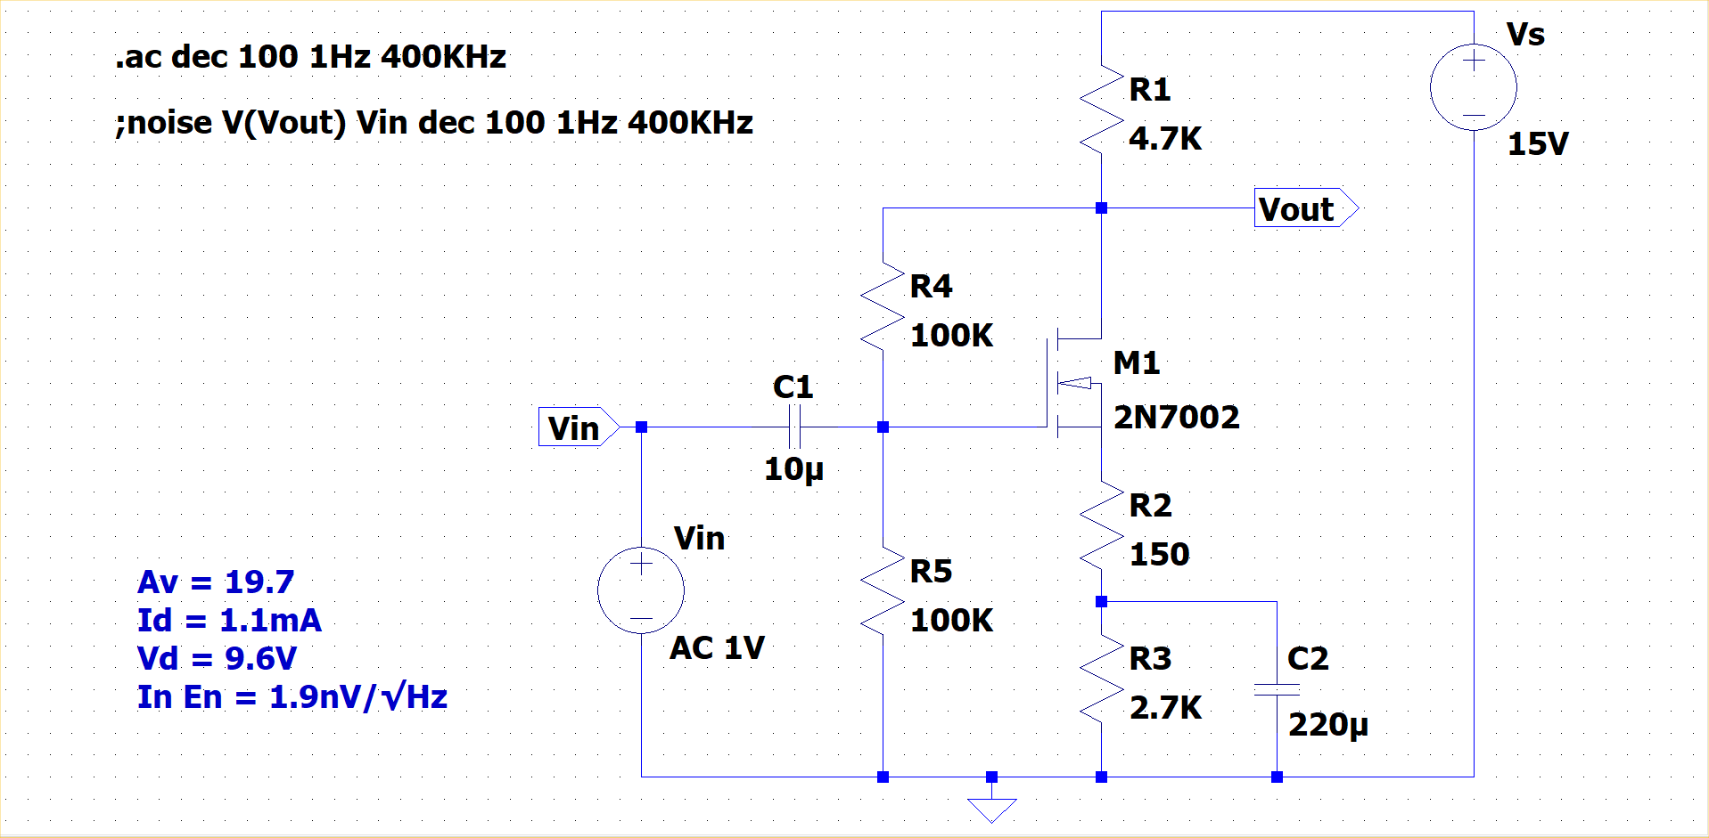
MOSFET common source biasing
Notes:
MOSFETs are difficult to bias in single stage, common source configuration because of the variability in their threshold voltage between samples of the same part. A 2N7000 is specified to have a Vt between 0.8V and 3.0V. With simplistic biasing, several volts have to be dropped across the source resistor to ensure that variations in threshold voltage don’t cause significant shifts in the operating points.
However, using a feedback biasing scheme similar to that described for the common emitter stage allows the quiescent output point to be reasonably consistent despite variations from sample to sample.
The circuit shown aims to put about 10V at the drain and 5V at the gate, with somewhere less than 5V at the source. Much of the design considerations of the common emitter stage can be applied to this circuit.
The feedback lowers the gain a little, but the circuit will give around x20. The input impedance is lowered, however, although it will still be reasonably large owing to the high intrinsic impedance of the MOSFET.

Slide 26
Appendix 1: The intrinsic emitter resistance
re = 25mV / Ic – Why?
At 25C, Vth = 86.17μV x 298 = 25.68mV ≈ 26mV
At 20C, Vth = 86.17μV x 293 = 25.24mV ≈ 25mV
I = Is( e^(V/Vth) – 1 ) = Is.e^(V/Vth) – Is
Is = 5 femtoamps = 5 x 10^(-15) A
I = Is.e^(V/Vth)
dI/dV = Is.e^(V/Vth).(1/Vth) = I / Vth
re = Vth / I
Notes:
That 25mV is the thermal voltage (Vth), equal to kT/q and comes from the physics of semiconductor conduction.
T is the absolute temperature in degrees Kelvin (0 ° Celsius = 273 Kelvin); k is Boltzmann’s constant; and q is the electron charge.
Now, k/q = 86.17 μV/K, so
At 25C, Vth = 86.17μV x 298 = 25.68mV ≈ 26mV.
At 20C, Vth = 86.17μV x 293 = 25.24mV ≈ 25mV.
Shockley's diode equation, which relates the current through a PN junction to the voltage across it, is:
I = Is( e^(V/Vth) – 1 ) = Is.e^(V/Vth) – Is
For a silicon diode, at 1mA we have a voltage drop of around 650mV, so we can calculate a typical Is:
Is = 1mA / (e^(650mV/25mV) – 1) = 1mA / (e^26 – 1) ≈ 1mA / (200,000,000,000) = 5 femtoamps or 5 x 10^(-15) A
When the diode is conducting, we can ignore the – Is term in Shockley’s equation which becomes:
I = Is.e^(V/Vth)
The rate of change of I with change of V is the differential of the diode equation:
dI/dV = Is.e^(V/Vth).(1/Vth) = I / Vth
But that is just the reciprocal of the rate of change of voltage with current – which is the resistance. So:
re = Vth / I

Slide 27
Appendix 2: Biasing the emitter and collector
The quiescent bias point for the emitter can be chosen to maximise the gain of the stage.
Av = Rc / Re
By making that voltage as small as practical, we make the emitter resistor as small as practical and maximise the gain.
The practical lower limit for the emitter resistor is when it is 10 times greater than the intrinsic emitter resistance.
Re = 10 x re = 10 x 25mV/Ic = 250mV / Ic
But the voltage across the emitter resistor is Re x Ic = 250mV
So we achieve the highest practical gain when the emitter voltage is biased to 250mV.
The quiescent bias point for the collector can be chosen so that the voltage swing at the collector is symmetrical up to clipping.
The positive swing will clip at the positive supply rail. At that point, Vc = Vcc (the supply voltage)
The negative swing will clip as the transistor enters saturation.
That occurs when the collector voltage drops to Vce(sat) above the emitter voltage (Ve).
So the collector can swing from Ve + Vce(sat) to Vcc.
The mid-point of that is:
Vc = ( Ve + Vce(sat) + Vcc ) / 2
If Ve ≈ 0.25V and Vce(sat) ≈ 0.2V, we can often ignore them and use Vc ≈ Vcc/2
The collector resistor is approximately (half the supply voltage) / Ic
So the ratio of Rc : Re ≈ (half the supply voltage)/Ic : 250mV/Ic = Vcc/2 : 250mV = Vcc : 500mV
But that is the gain, so the highest practical gain is:
Av = Vcc/0.5V
Notes:
Av is the voltage gain of the common emitter circuit.
Rc is the collector resistance.
Re is the emitter resistance (unbypassed), assumed to be >> the intrinsic emitter resistance.
Ic is the collector current, assumed to be equal to the emitter current (i.e. β >> 1).

Slide 28
Appendix 3: Base voltage and input impedance
With a split bypassed emitter resistor, the quiescent bias point for the base can be calculated when Ib is significant.
Assuming Ie = Ic (i.e. β >> 1), the current flowing through R1 must equal the current through R2 and through Ib:
(Vcc – Vb)/R1 = Vb/R2 + Ib = Vb/R2 + Ie/β
Ie = (Vb – Vbe)/(R4 + R5)
(Vcc – Vb)/R1 = Vb/R2 + (Vb – Vbe)/β(R4 + R5)
We can treat β(R4+R5) as the dc input resistance of the transistor looking into the base, so call it Rb.
(Vcc – Vb)/R1 = Vb/R2 + (Vb – Vbe)/Rb
Vcc/R1 – Vb/R1 = Vb/R2 + Vb/Rb – Vbe/Rb
Vcc/R1 + Vbe/Rb = Vb/R2 + Vb/Rb + Vb/R1
Vcc/R1 + Vbe/Rb = Vb(1/R2 + 1/Rb + 1/R1)
Vb = (Vcc/R1 + Vbe/Rb) / (1/R1 + 1/R2 + 1/Rb)
The parallel combination of R1, R2 and Rb is 1/(1/R1+1/R2+1/Rb), so:
Vb = (Vcc/R1 + Vbe/Rb) . (R1 || R2 || Rb)
The ac input impedance is the parallel combination of R1, R2 and the ac input resistance of the transistor looking into the base.
At frequencies where Xc2 << (R4+re), the latter is β(R4 + re), where re = 25.5mV/Ic.
It is useful to consider (R4+R5) to be the dc emitter resistance and β(R4 + R5) the dc base resistance.
Similarly, (R4+re) is the ac emitter resistance, and β(R4 + re) is the ac base resistance.
Zin = R1 || R2 || β(R4 + re)
Zin = 1 / ( 1/R1 + 1/R2 + 1/β(R4 + re) )

